Slide 1
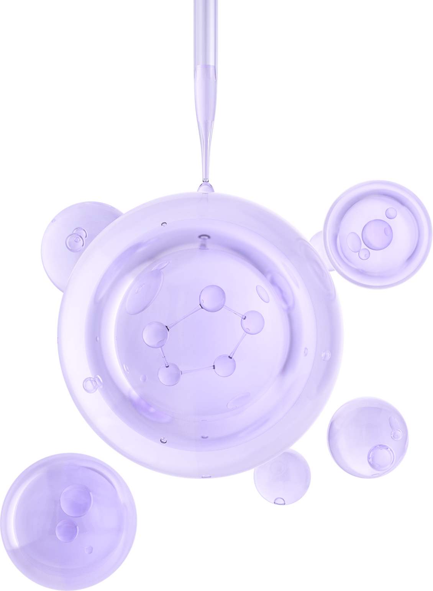

UNIVERSITY OF BASRAH / COLLEGE OF SCIENCE
LECTURE PhD. 4
Metabolism of Microbes
Department of Biology
Prof.Dr. Saad S. Mahdi Al-Amara

Slide 2
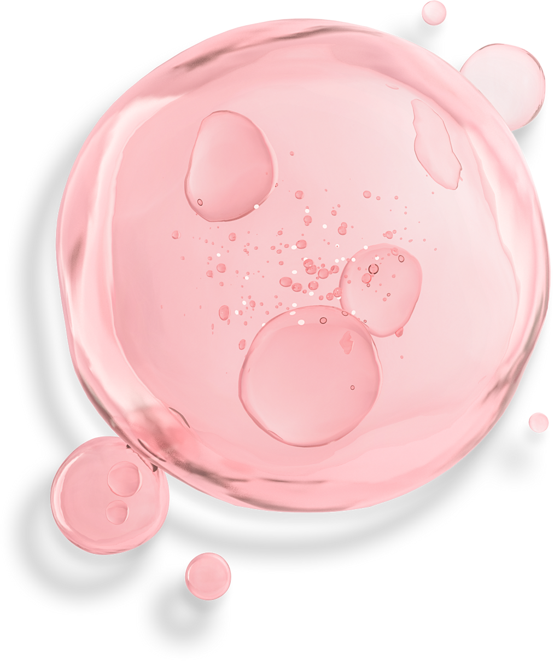
The Metabolism of Microbes
Metabolism, from the Greek term metaballein, meaning change, pertains to all chemical reactions and physical workings of the cell.
Metabolism entails thousands of different reactions, most of them fall into one of two general categories.
Anabolism, sometimes also called biosynthesis, is any process that results in synthesis of cell molecules and structures. It is abuilding and bond-making process that forms larger macromolecules from smaller ones, and it usually requires the input of energy
Catabolism is the opposite of anabolism. Catabolic reactions break the bonds of larger molecules into smaller molecules and often release energy. The linking of anabolism to catabolism ensures the effcient completion of many thousands of cellular processes.

Slide 3
In summary, metabolism performs these functions
1. assembles smaller molecules into larger macromolecules needed for the cell; in this process, ATP (energy) is utilized to form bonds (anabolism) .
2. degrades macromolecules into smaller molecules, a process which yields energy (catabolism) .
3. conserves energy in the form of ATP (adenosine triphosphate) or heat .
A microbial cell could be viewed as a microscopic factory, complete with basic building materials, a source of energy, and a “blueprint” for running its extensive network of metabolic reactions. But the chemical reactions of life, even when highly organized and complex, cannot proceed without a special class of macromolecules called enzymes.
Enzymes are a remarkable example of catalysts, chemicals that increase the rate of a chemical reaction without becoming part of the products or being consumed in the reaction .

Slide 4
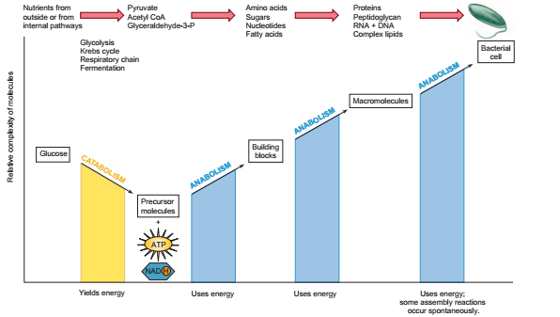
Figure 8.1 Simplified model of metabolism. Cellular reactions fall into two major categories. Catabolism involves the breakdown of complex organic molecules to extract energy and form simpler end products. Anabolism uses the energy to synthesize necessary macromolecules and cell structures from precursors.

Slide 5
How Do Enzymes Work?
We have said that an enzyme speeds up the rate of a metabolic reaction, but just how does it do this?
During a chemical reaction, reactants are converted to products by bond formation or breakage.
A certain amount of energy is required to initiate every such reaction, which limits its rate. This resistance to a reaction, which must be overcome for a reaction to proceed, is
measurable and is called the energy of activation or activation energy. In the laboratory, overcoming this initial resistance can be achieved by:
1. increasing thermal energy (heating) to increase molecular velocity.
2. increasing the concentration of reactants to increase the rate of molecular collisions, or
3. adding a catalyst.

Slide 6
At the molecular level, an enzyme promotes a reaction by serving as a physical site upon which the reactant molecules, called substrates, can be positioned for various interactions.
The enzyme is much larger in size than its substrate, and it presents a unique active site that its only that particular substrate.
Although an enzyme binds to the substrate and participates directly in changes to the
substrate, it does not become a part of the products, is not used up by the reaction, and can function over and over again
Enzyme Structure
The primary structure of most enzymes is protein- with some exceptions and they can be classifed as simple or conjugated.
Simple enzymes consist of protein alone, whereas conjugated enzymes (fgure 2.2) contain protein and nonprotein molecules.

Slide 7
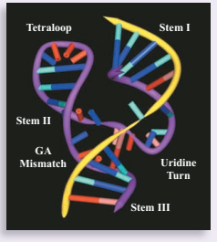
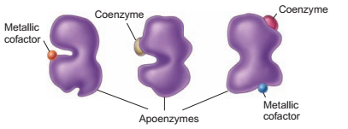
Figure 2.2 UnConjugated enzyme structure
Figure 2.3 Conjugated enzyme structure. All have an apoenzyme (polypeptide or protein) component and one or more of actors .

Slide 8
A conjugated enzyme, sometimes referred to as a holoenzyme, is a combination
of a protein, now called the apoenzyme, and one or more cofactors.
Cofactors are either organic molecules, called coenzymes, or inorganic elements (metal ions).
For example, catalase, an enzyme that breaks down hydrogen peroxide, requires iron as a metallic cofactor .
Apoenzymes: Specificity and the Active Site Apoenzymes range in size from small polypeptides with about 100 amino acids and a molecular weight of 12,000 to large polypeptide conglomerates with thousands of amino acids and a molecular weight of over 1 million.
Like all proteins, an apoenzyme exhibits levels of molecular complexity called the primary, secondary, tertiary, and, in larger enzymes, quaternary organization (fgure 2.3).

Slide 9
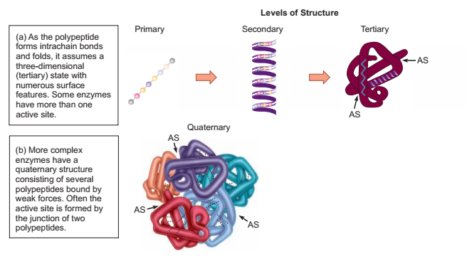
Figure 2.3 How the active site and specificity of the apoenzyme arise.

Slide 10
The first three levels of structure arise when a single polypeptide chain undergoes an automatic folding process and achieves stability by forming disulfde and other
types of bonds.
Folding causes the surface of the apoenzyme to acquire three-dimensional features that result in the enzyme’s specify city for substrates.
The actual site where the substrate binds is a crevice or groove called the active site, or catalytic site, and there can be from one to several such sites (see figure 2.3).
Each type of enzyme has a different primary structure (type and sequence of amino acids), variations in folding, and unique active sites.
Enzyme-Substrate Interactions
For a reaction to take place, a temporary enzyme-substrate union must occur at the active site (figure 2.4).
The fit is so specific that it is often described as a “lock-and-key” fit in which the substrate is inserted into the active site’s pocket.

Slide 11
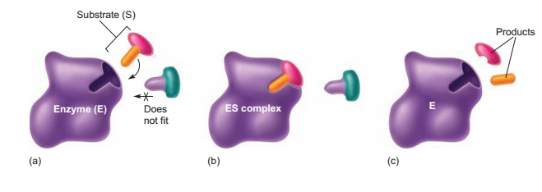
Figure 2.4 Enzyme-substrate
reactions. (a) When the enzyme and substrate come together, the substrate (S) must show the correct fit and position with respect to the enzyme (E). (b) When the ES complex is formed, it enters a transition
state. During this temporary but tight interlocking union, the enzyme participates directly in breaking or making bonds. (c) Once the reaction is complete, the enzyme releases the products.
The bonds formed between the substrate and enzyme are weak and, of necessity, easily reversible.
Once the enzymesubstrate complex has formed, appropriate reactions occur on
the substrate, often with the aid of a cofactor, and a product is formed and released.
The enzyme can then attach to another substrate molecule and repeat this action , Although enzymes can potentially catalyze reactions in both directions .

Slide 12
Cofactors: Supporting the Work of Enzymes
You learned that microorganisms require specific metal ions called trace elements and certain organic growth factors. In many cases, the need for these substances arises from their roles as cofactors for enzymes.
The metallic cofactors, including iron, copper, magnesium, manganese, zinc, cobalt, selenium, and many others, participate in precise functions between the enzyme
and its substrate.
In general, metals activate enzymes , help bring the active site and substrate close together, and participate directly in chemical reactions with the enzymesubstrate complex.
Coenzymes are a type of cofactor. They are organic compounds that work in conjunction with an apoenzyme to perform a necessary alteration of a substrate.
The general function of a coenzyme is to remove a chemical group from one substrate molecule and add it to another substrate, thereby serving as a transient carrier of this
group.

Slide 13
Classification of Enzyme Functions
Enzymes are classified and named according to characteristics such as site of action, type of action, and substrate , Most metabolic reactions require separate and unique enzymes.
A standardized system of nomenclature and classification , in general, an enzyme name is composed of two parts: a prefix or stem word derived from a certain characteristic , usually the substrate acted upon or the type of reaction catalyzed, or both , followed by the ending -ase.
The system classifies the enzyme in one of these six classes,on the basis of its general biochemical action:
Oxidoreductases transfer electrons from one substrate to another, and dehydrogenases transfer a hydrogen from one compound to another.
2. Transferases transfer functional groups from one substrate to another.
3. Hydrolases cleave bonds on molecules with the addition of water.
4. Lyases add groups to or remove groups from double-bonded substrates.

Slide 14
5. Isomerases change a substrate into its isomeric form.
6. Ligases catalyze the formation of bonds with the input of ATP and the removal of water.
Each enzyme is also assigned a common name that indicates the specific reaction it catalyses. With this system, an enzyme that digests a carbohydrate substrate is a carbohydrase; a specificcarbohydrase, amylase, acts on starch (amylose is a major component of starch).
The enzyme maltase digests the sugar maltose. An enzyme that hydrolyzes peptide bonds of a protein is a proteinase, protease, or peptidase, depending on the size of the protein substrate.
Some fats and other lipids are digested by lipases.
DNA is hydrolyzed by deoxyribonuclease, generally shortened to DNase.A synthetase or polymerase bonds together many small molecules into large molecules.
Other examples of enzymes are presented in table 2.1.

Slide 15
Table 2.1 A Sampling of Enzymes , their Substrates and Their Reaction
Lactase | β-D-galactosidase | Hydrolase | Lactose | Breaks lactose down into glucose and galactose
Penicillinase | Beta-lactamase | Hydrolase | Penicillin | Hydrolyzes beta-lactam ring
DNA polymerase | DNA nucleotidyl transferase | Transferase | DNA nucleosides | Synthesizes a strand of DNA using the complementary strand as a model
Lactate dehydrogenase | Same as common name | Oxidoreductase | Pyruvic acid | Catalyzes the conversion of pyruvic acid to lactic acid
Oxidase | Cytochrome oxidase | Oxidoreductase | Molecular oxygen | Catalyzes the reduction of O2 (addition of electrons and hydrogen)

Slide 16
Location and Regularity of Enzyme Action
Enzymes perform their tasks either inside or outside of the cell in which they were produced.
Endoenzymes are retained intracellularly and function there.
Exoenzymes are transported extracellularly ,where they break down (hydrolyze) large food molecules or harmful chemicals. Examples of exoenzymes are cellulase, amylase, and penicillinase. (figure 2.5).
The enzymes are not all produced in equal amounts or at equal rates. Some, called
constitutive enzymes (figure 2.6a), are always present and in relatively constant amounts, regardless of the amount of substrate.
The enzymes involved in utilizing glucose, for example, are very important in metabolism and thus are constitutive .
Other enzymes are regulated enzymes (figure 2.6b), the production of which is either turned on (induced) or turned off (repressed) in response to changes in concentration of the substrate.

Slide 17
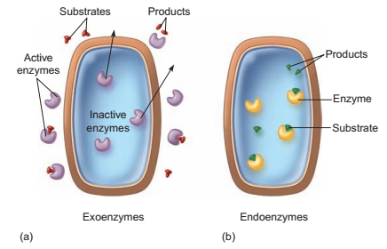
Figure 2.5 Types of enzymes, as described by their location of action. (a) Exoenzymes are released outside the cell to function. (b) Endoenzymes remain in the cell and function there.

Slide 18
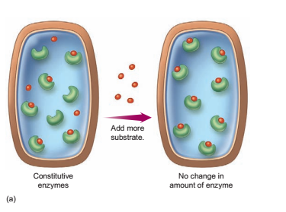
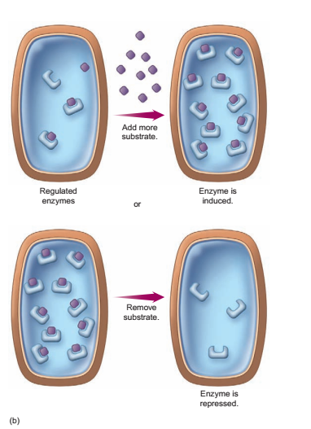
Figure 8.6 Constitutive and regulated enzymes.
(a) Constitutive enzymes are present in constant amounts in a cell . The addition of more substrate does not increase the numbers of
these enzymes.
(b) The concentration of regulated enzymes in a cell increases or decreases in response to substrate levels.

Slide 19
Synthesis and Hydrolysis Reactions
A growing cell is in a frenzy of activity, constantly synthesizing proteins, DNA, and RNA; forming storage polymers such as starch and glycogen; and assembling new cell parts.
Such anabolic reactions require enzymes (ligases) to form covalent bonds between
smaller substrate molecules.
Also known as dehydration reactions, synthesis reactions typically require ATP and release
one water molecule for each bond made (figure 2.7a).
Catabolic reactions involving energy transactions, remodeling of cell structure, and digestion of macromolecules are also very active during cell growth. For example, digestion requires enzymes to break down substrates into smaller molecules so they can be used by the cell.
Because the breaking of bonds requires the input of water, digestion is often termed a
hydrolysis reaction (figure 2.7b).

Slide 20
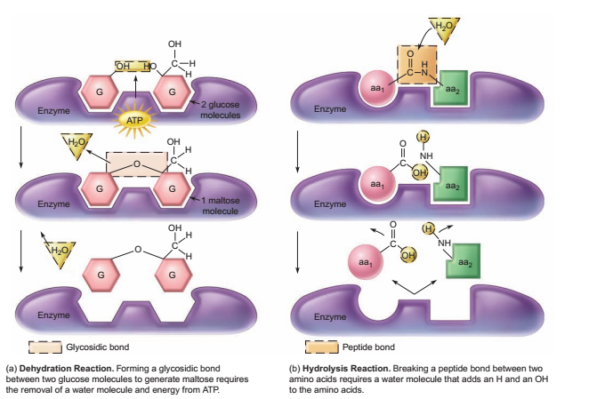
Figure 2.7 Examples of enzyme-catalyzed synthesis and hydrolysis reactions.

Slide 21
THANK YOU

